Slide 1




NutriGenius
Solutions to The Stunting Problem in Indonesia
Theme: Human Healthcare and Living Wellbeings
Capstone Type: Product-based Project

Slide 2



CH2-PR635 Team
Teuku Nurmansyah Puteh (MD - A314BSY2063)
Fiqri Rasyidiq (ML - M302BSY0936)
Muhammad Ahnaf Zalfa (ML - M214BSY1912)
As’ad Reza Amaanullah (CC - C676BSY3624)
Pieter Rafael Johansz (CC - C006BSY3921)
Rizki Santriani (CC - C156BSX3410)

Slide 3
Project Background
Stunting is a nutritional problem that needs special treatment, especially in poor and developing countries. Literally, stunting is a condition of failure to grow in children under five caused by chronic nutritional deficiencies and the inability to meet the child's nutritional standards.
Based on research data from the Ministry of Health, before the emergence of the COVID-19 pandemic, around 6.3 million toddlers out of Indonesia's total toddler population of 23 million experienced stunting. In fact, the prevalence of stunted toddlers in Indonesia in 2019 reached 27.7%. This puts Indonesia in fourth place globally as the country with the highest cases of stunting.

Slide 4



Why should we put a caution on this stunting case?
If left unchecked for a long time, Indonesia will indirectly ignore human rights in terms of the welfare of its people.
Stunting will have an impact on the country's economic progress due to inadequate human resources.
Indonesia has the potential to get a bad reputation in the international world, which is correlated with stunting cases which are still high.

Slide 5
Existing Result
Of course, all parties involved want to create new breakthroughs to reduce the frequency of stunting in Indonesia. Various efforts have been made to achieve this.
In our group, we take the initiative to differentiate through certain features:
Food scanning feature that shows the nutritional levels contained
Article features as a form of education for parents
Consultation feature with nutrition experts to obtain constructive recommendations
Our group feels that these three points are still rarely found in other product prototypes. The hope is that the features described above will maximize the real reduction in stunting in Indonesia.

Slide 6
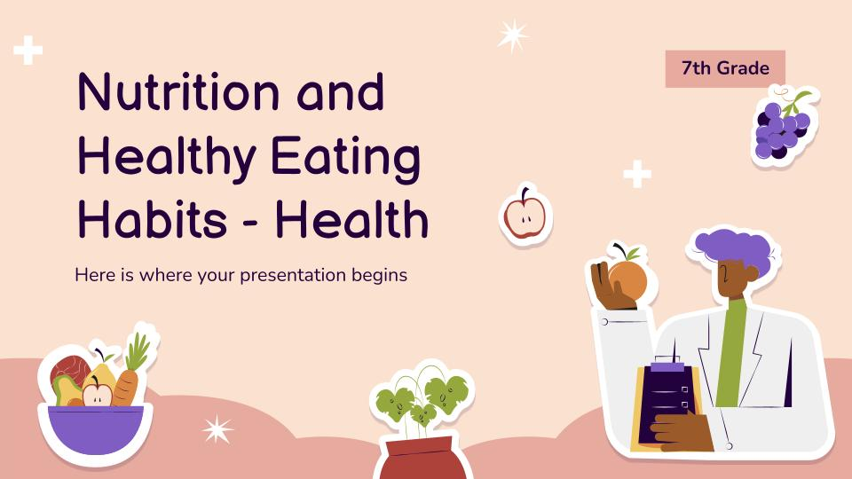
NutriGenius
Aplication
NutriGenius is an innovative project that aims to overcome the problem of stunting in Indonesian children through a combination of technology and nutrition education.

Slide 7

1. Nutrition Monitoring
provides a regular monitoring feature regarding children's nutritional status. Parents or caregivers can enter data such as the child's age, weight, height, and nutritional condition. This application will provide visual reports that are easy to understand, such as a graph of a child's growth over time.

Slide 8
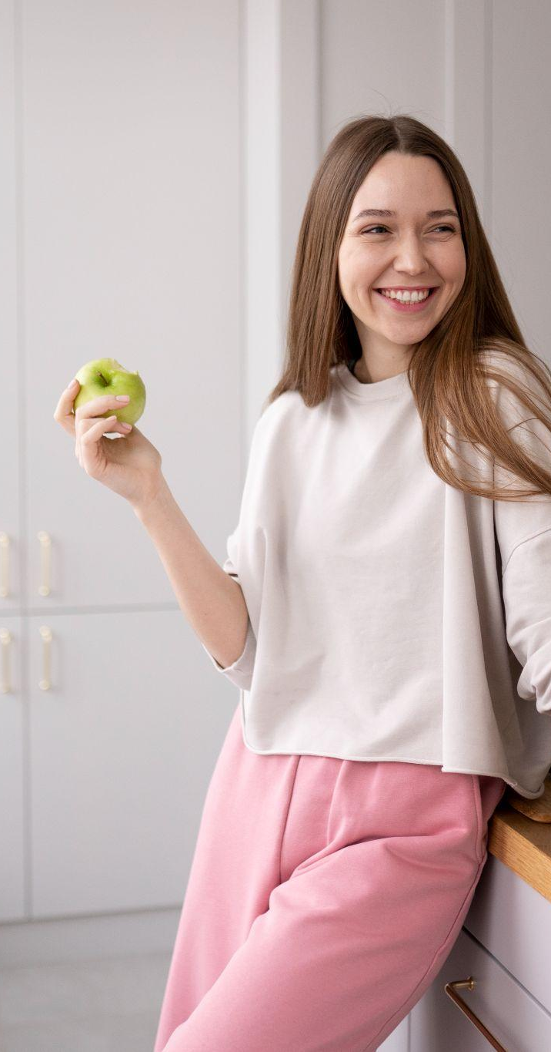
2. Recommendations feature
provides recommendations for balanced menus and nutritious food recipes according to the nutritional status data entered. Users can also obtain information regarding the urgency of certain nutritional intake for children's optimal growth.

Slide 9
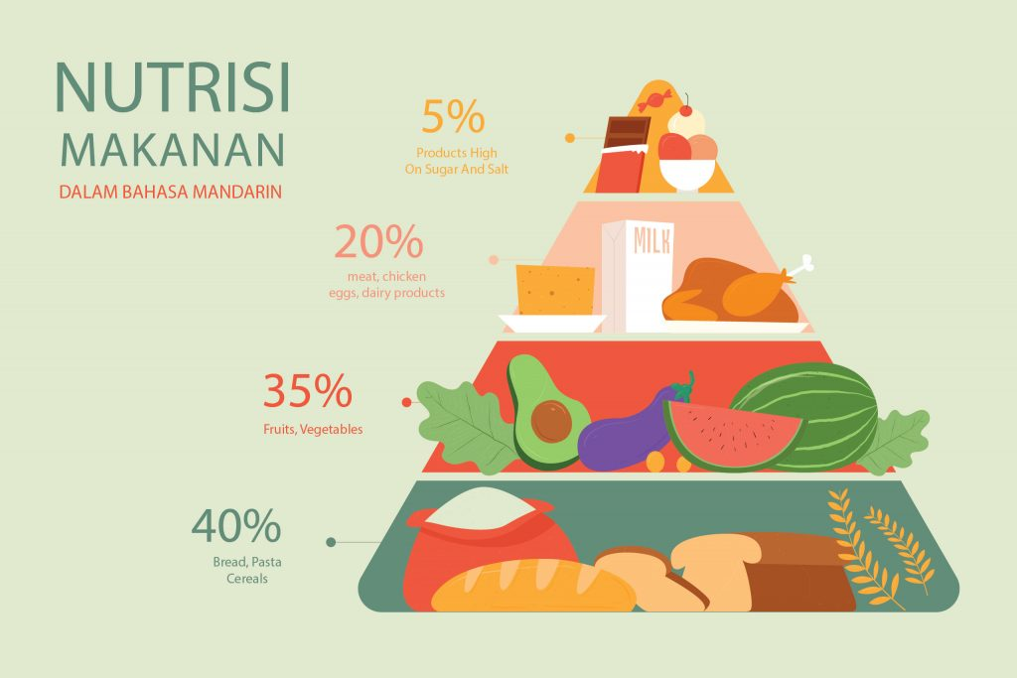
3. Nutrition Education
provides health articles and educational information about nutrition to help inspire parents to understand their children's nutritional needs.

Slide 10

4. Scanning Food
provides food photo-taking services using cellphone cameras; The application will automatically identify types of food and provide an overview of their nutritional composition, making it easier for users to make wise decisions regarding their child's growth and development.

Slide 11
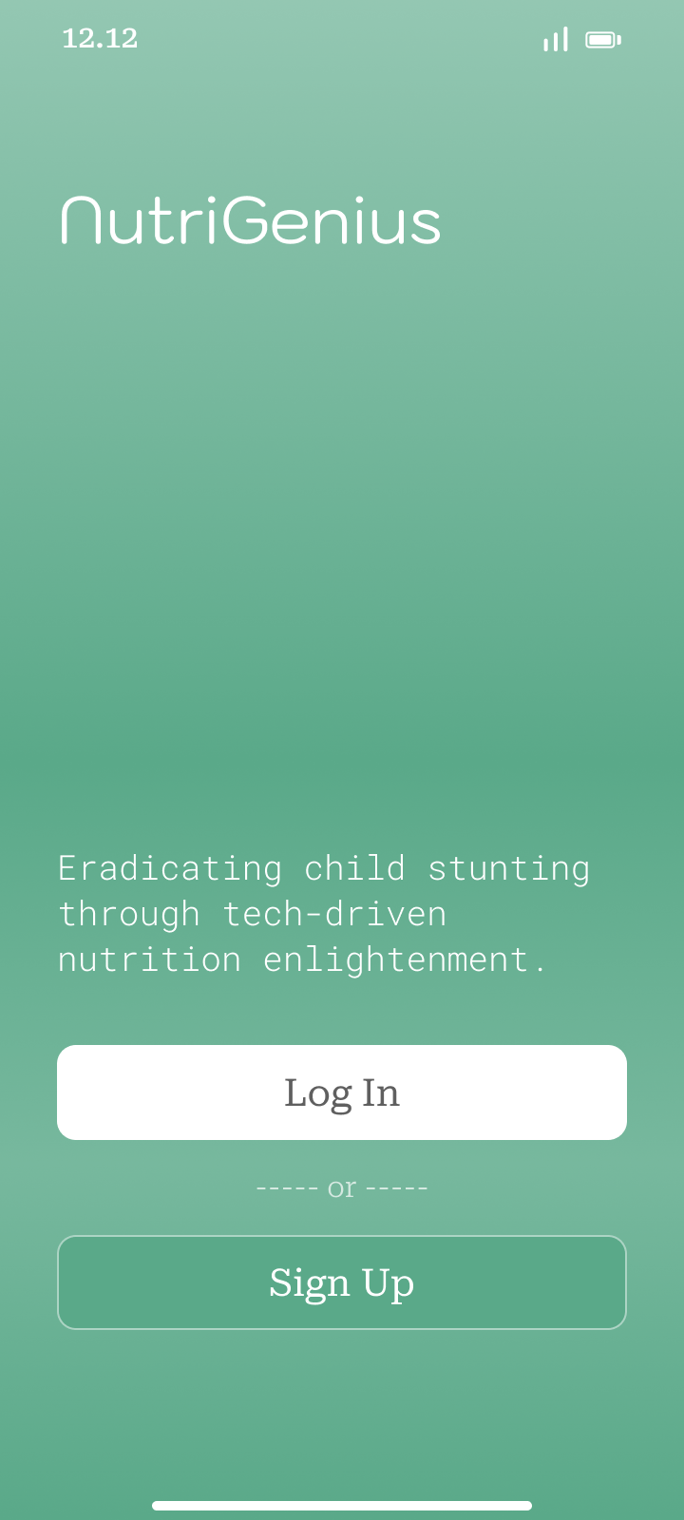
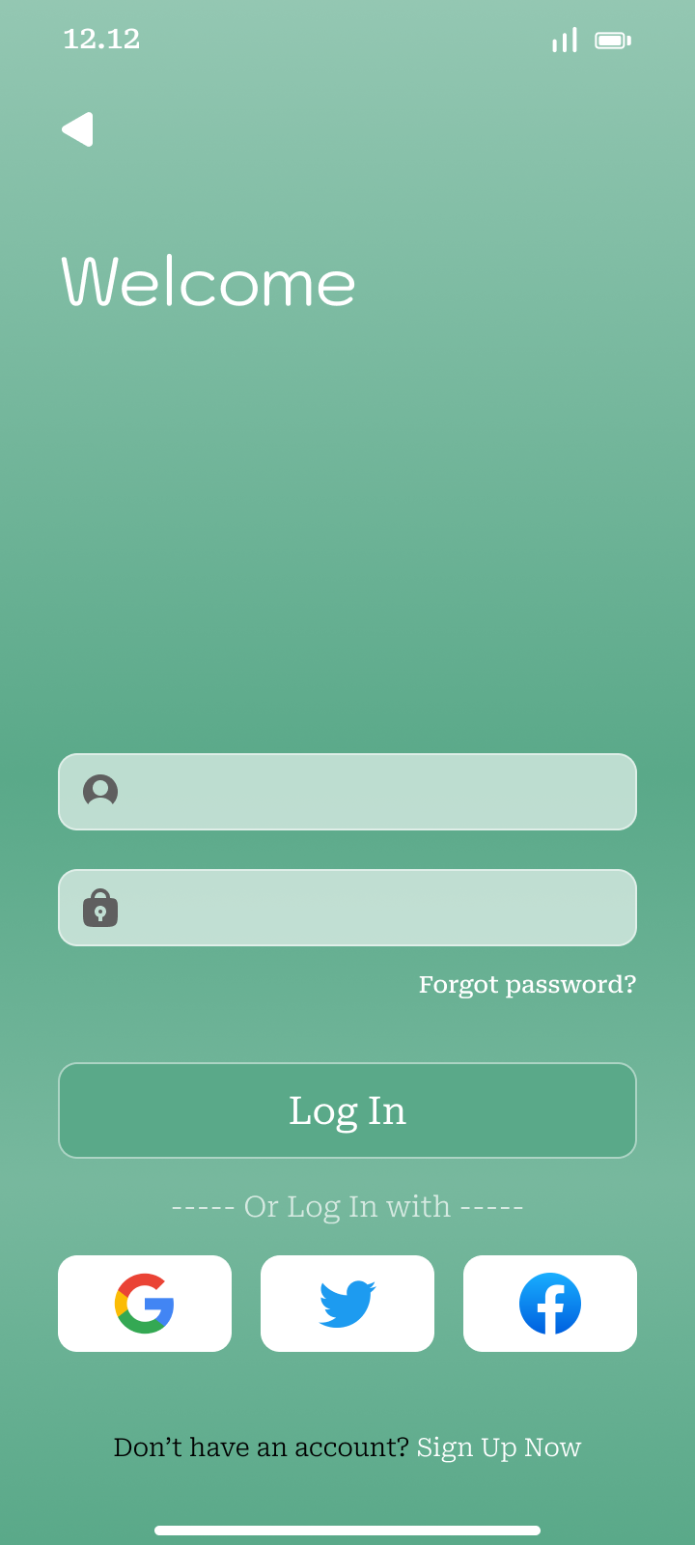
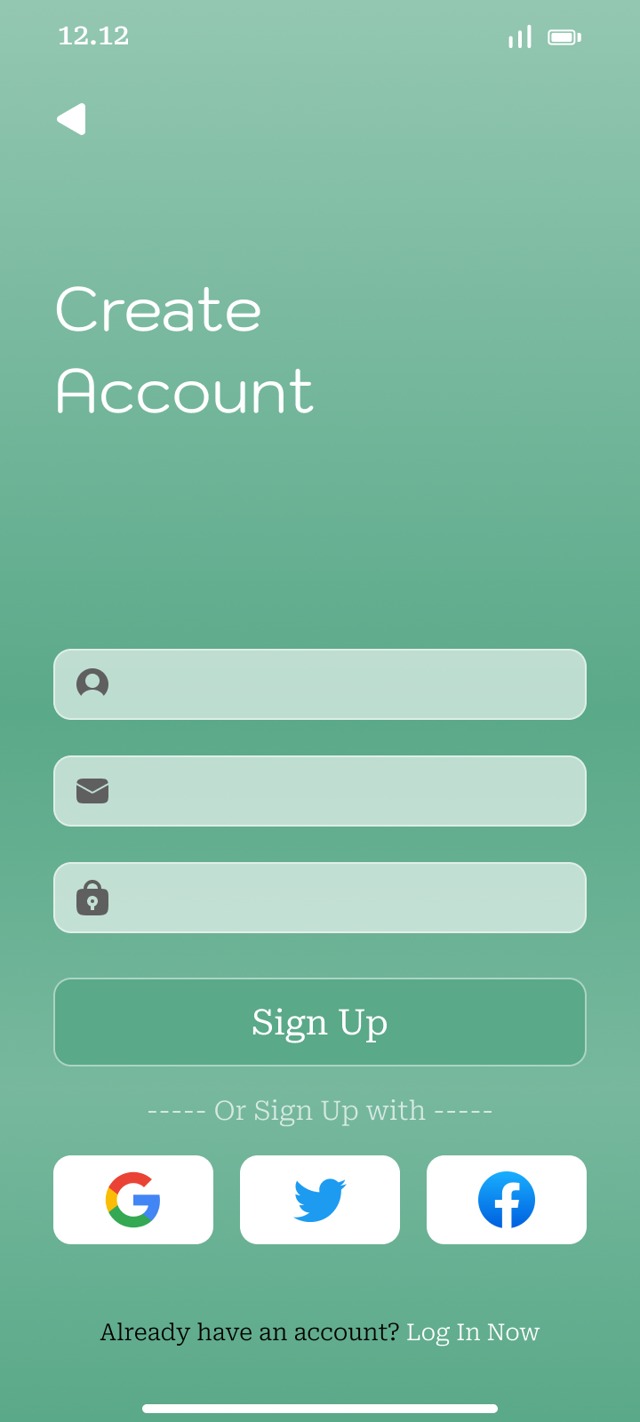
Result: Login / Signup

Slide 12
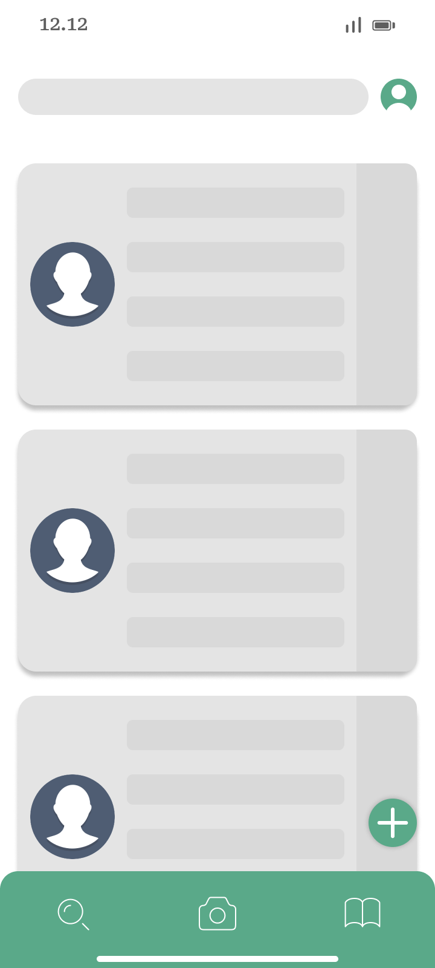
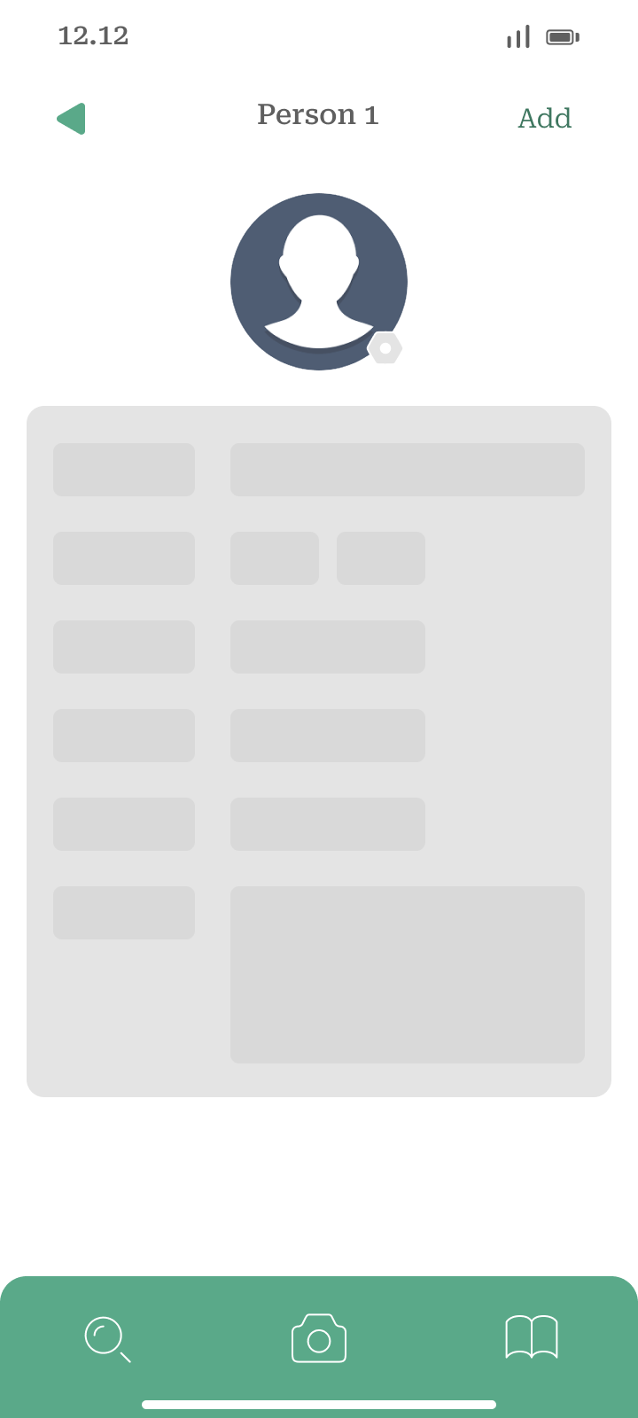
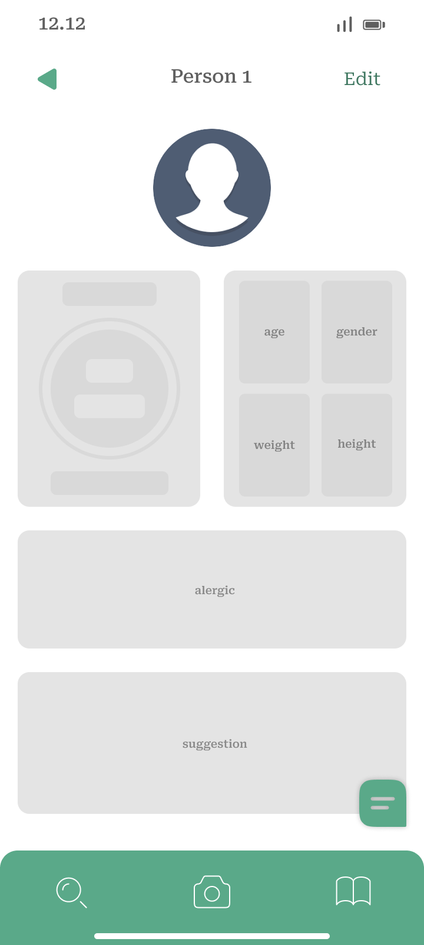
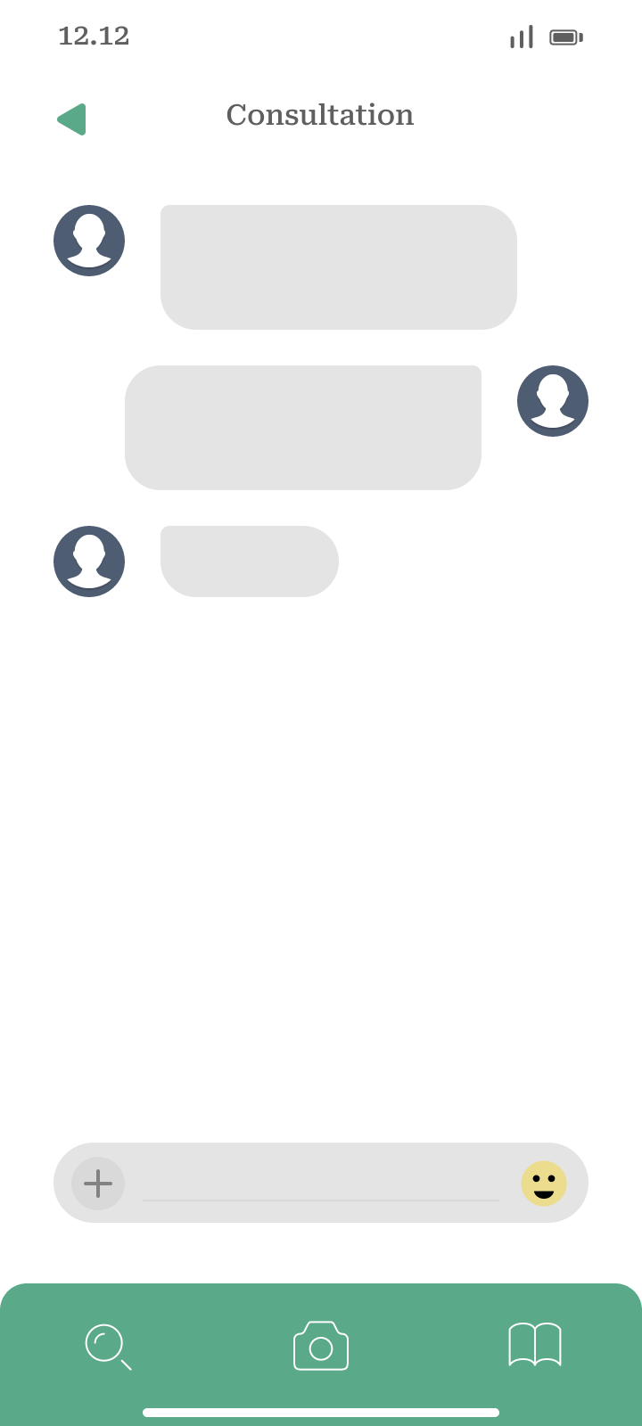

Result: Monitoring Page / Add / Detail / Edit / Consultation

Slide 13
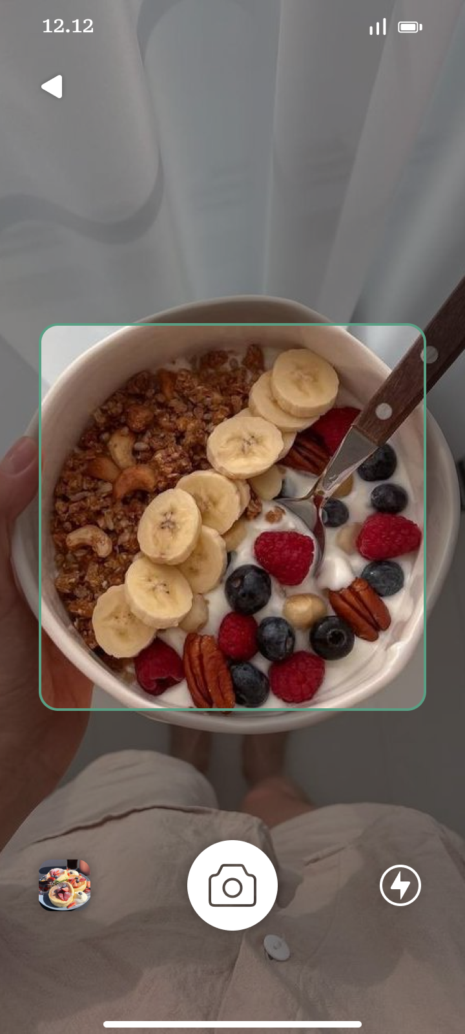
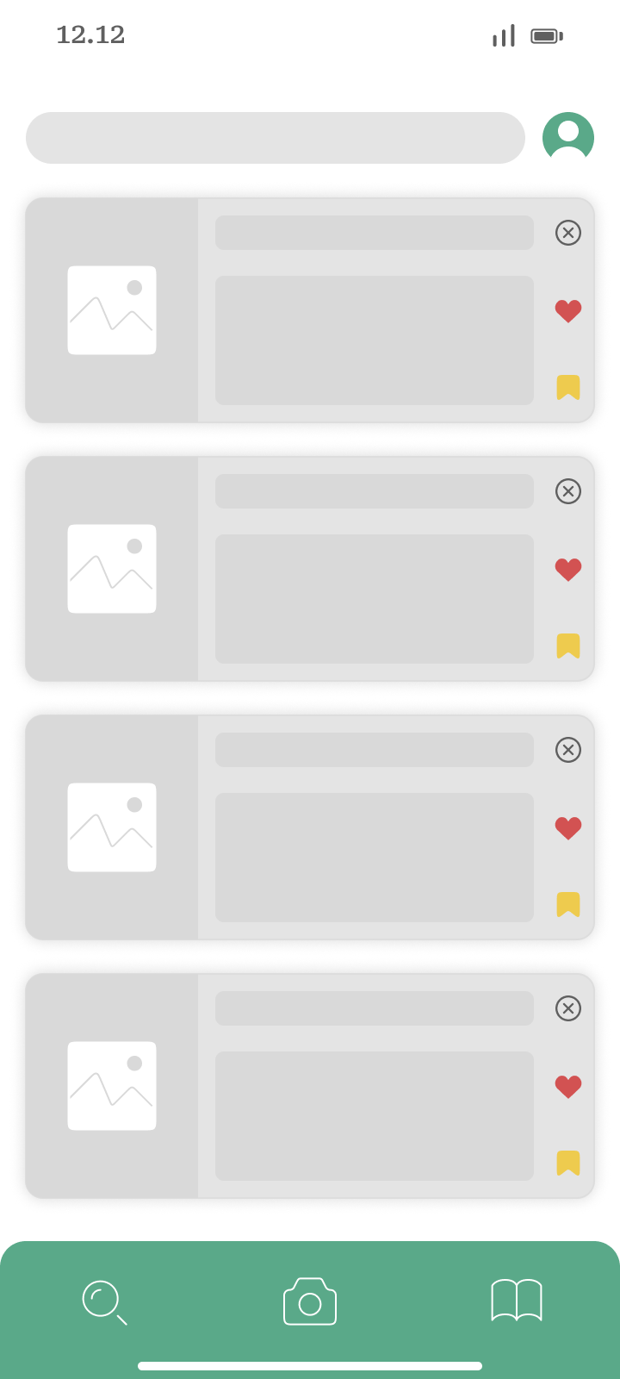
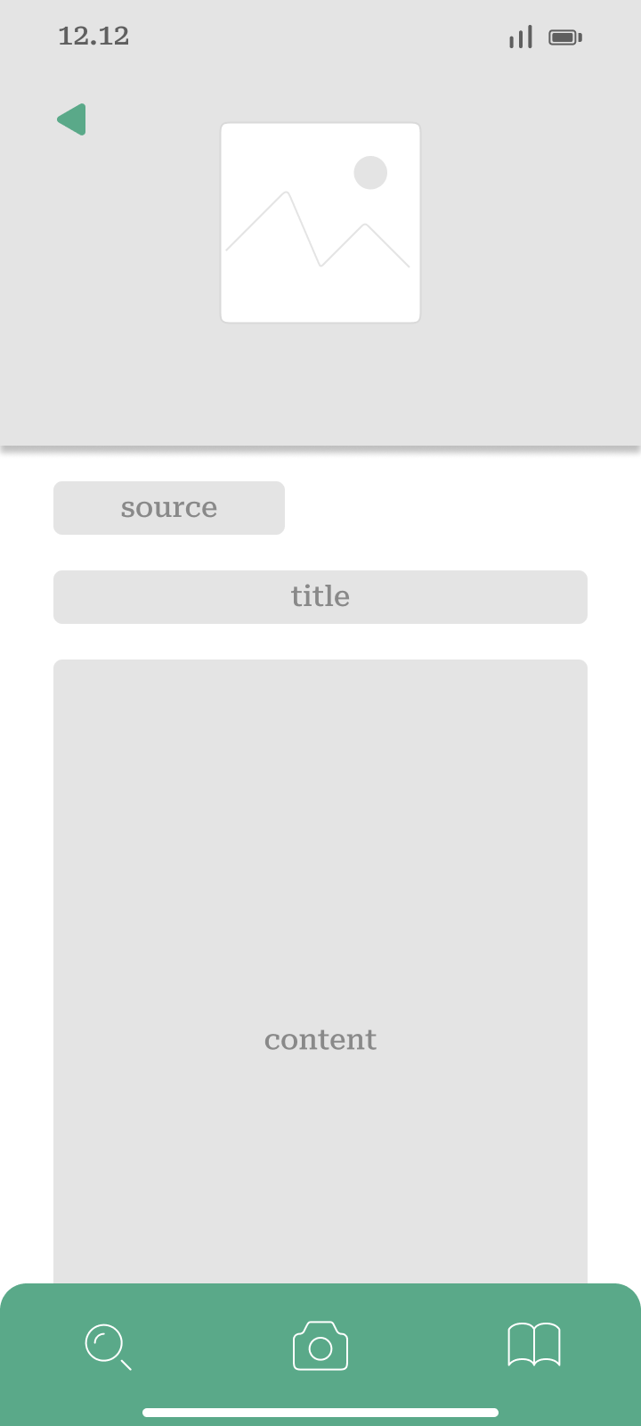
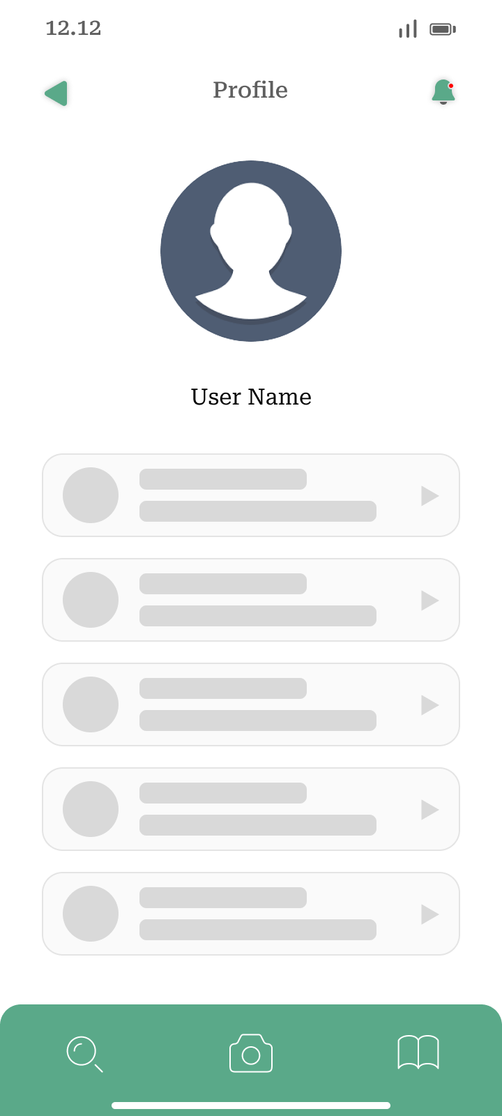
Result:
Scanning / Article / Article Detail / Profile

Slide 14
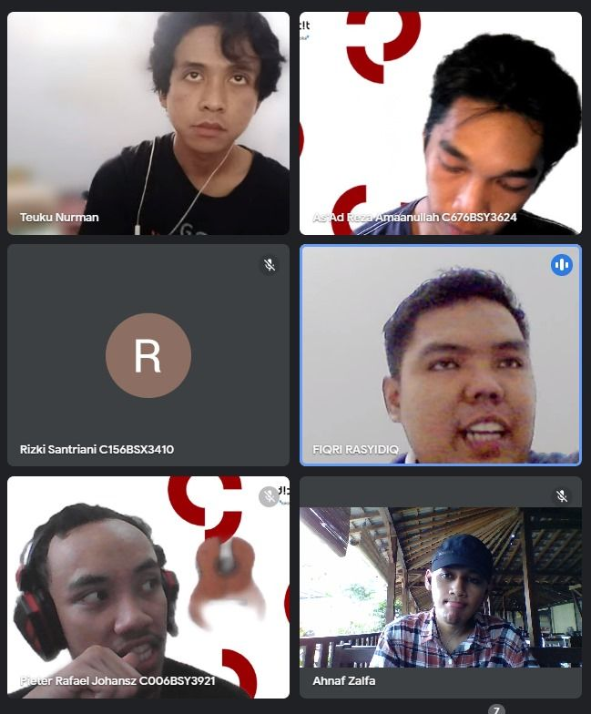
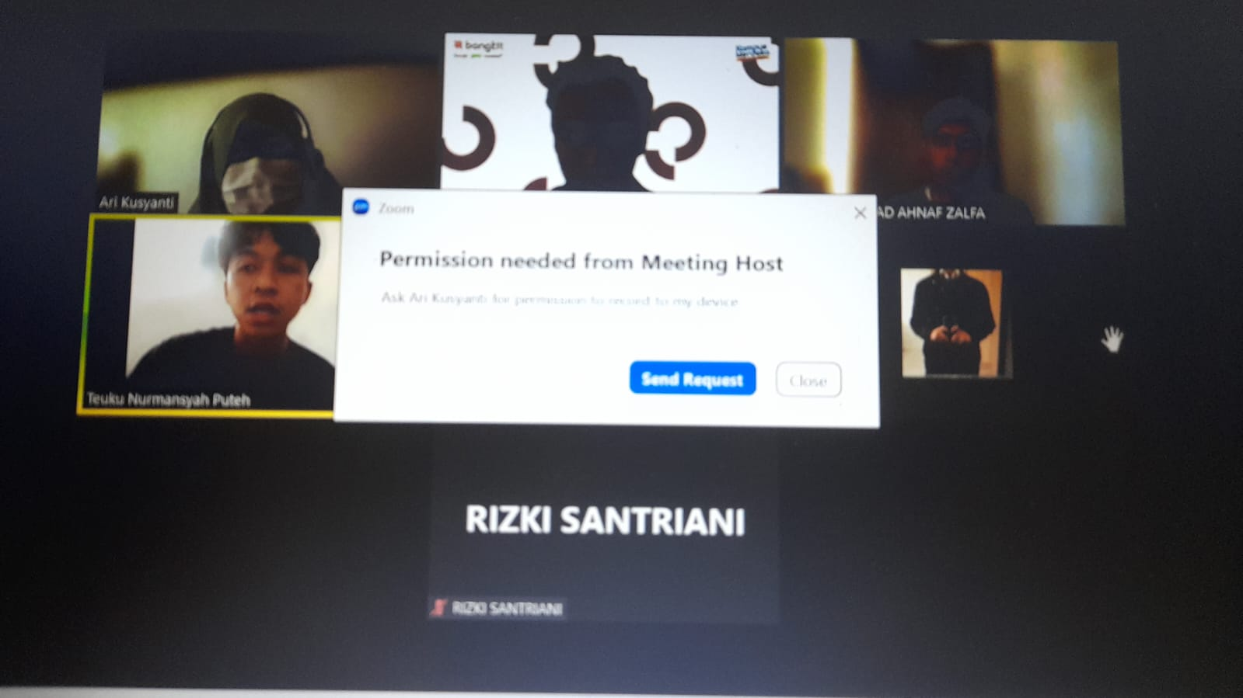
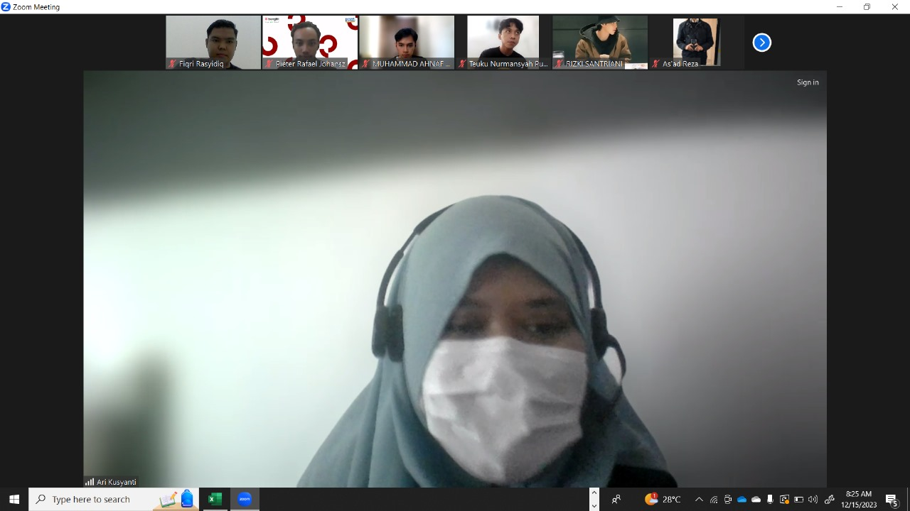
Documentation
Some of our activities in the process of working on the capstone project are as follows:
Team Meeting
November, 9, 2023
Mentoring Session with Advisor at December, 15, 2023
Mentoring Session with Advisor at December, 15, 2023

Slide 15
Deployment and Business Pitch
In strategizing the local deployment of NutriGenius, we're meticulously engaging key stakeholders, aligning with local health authorities and community organizations. Our focus includes optimizing the app for local infrastructure, ensuring a smooth integration process. With a user-friendly onboarding system in place and community-centric engagement initiatives, we aim to create widespread awareness and accessibility.
Simultaneously, our business pitch emphasizes NutriGenius's value, highlighting user-friendly features, real-time monitoring, and positive impacts on childhood nutrition. The go-to-market proposal entails a targeted marketing approach, competitive pricing, and strategic partnerships with local institutions for extended outreach. This comprehensive strategy is designed to seamlessly introduce NutriGenius to the local community, aligning with their needs and promoting sustainable health initiatives.

Slide 16
Thanks!
Do you have any questions?
youremail@freepik.com
+34 654 321 432
yourwebsite.com
Please keep this slide for attribution

